Slide 1
Cruise Ship Management System
Using HTML, CSS, JS, and FireBase

Slide 2
Introduction
Overview: A web application designed to manage cruise ship operations efficiently, allowing voyagers to place orders for various services, such as catering, stationery, resort bookings, fitness center reservations, and party hall bookings.
Target Users: Voyagers, Administrators, Managers, Head-Cooks, Supervisors.
Objective: Improve the customer experience by enabling voyagers to book and order services from their devices without visiting multiple departments.

Slide 3
Problem Statement
Current Issue: Voyagers have to go to different departments for services, which is inconvenient and time-consuming..
Solution: Develop a web-based platform where voyagers can place orders and book services online, including:
Catering: Snacks, food, and beverages
Stationery: Gift items, chocolates, tale books
Tickets: Resort movies, beauty salon, fitness center, and party hall bookings
Party Hall: Different types of gatherings like birthday, wedding, etc

Slide 4
System Modules
1. Voyager
Login: Username and password-based authentication
Services:
Catering Orders: Choose snacks, food, and beverages.
Stationery Orders: Select gift items and other stationery.
Bookings: Make reservations for resort-movies, beauty salon, fitness center, and party hall.
2. Admin
Admin Login: Username and password-based authentication.
Functions:
Item Management: Add, edit, or delete menu items and other services.
Voyager Registration: Manage voyager accounts.
3. Manager
View Bookings: Track booked resort-movie tickets, beauty salon appointments, fitness center schedules, and party hall reservations.
4. Head-Cook
Catering Orders: View and manage catering orders made by voyagers.
5. Supervisor
Stationery Orders: View and manage stationery item orders made by voyagers

Slide 5
Project Architecture and Design
Frontend Design:
UI/UX: A clean, user-friendly interface with a responsive design for all devices.
Features: Login system, search options for different services, interactive menus, and booking forms.
Backend Design:
Database: Firebase used for storing user data, bookings, and order details.
Authentication: Firebase Authentication to securely log in users (Voyagers, Admins, Managers, etc.).
Logging:
Use of JavaScript's console.log or Python's logging library to record user actions and system events.
Optimization:
Code Level: Modular code structure for easier maintenance and scalability.
Architecture Level: Well-structured database with separate collections for voyagers, bookings, catering, and stationery.

Slide 6
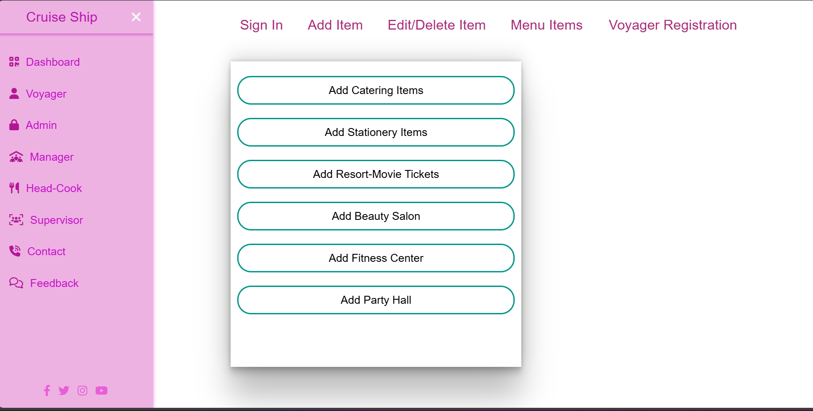
System Workflow

Slide 7
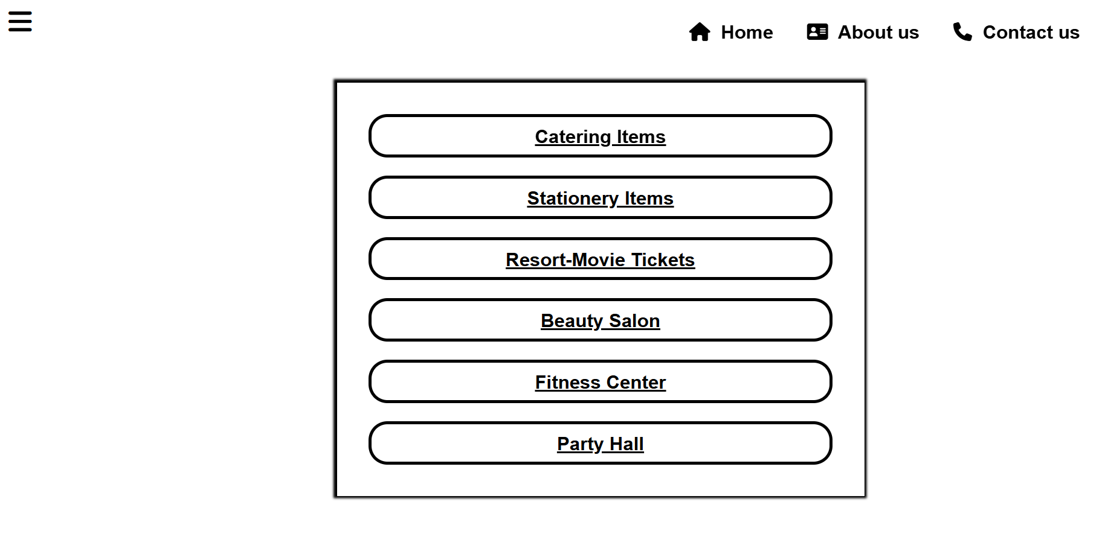
1. Voyager Workflow
Sign In: The voyager logs in with their username and password.
Select Services: After login, the voyager selects the service (Catering, Stationery, Resort Movie, etc.).
Place Orders: The voyager places their order for selected services, confirming the booking.

Slide 8
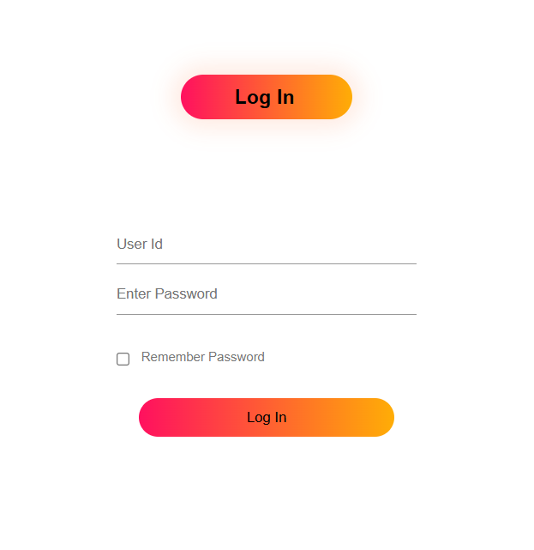
2. Admin Workflow
Login: Admin signs in to manage the system.
Manage Items: Admin can add, edit, or delete items from the catalog (food, drinks, books, etc.).
User Management: Admin can view and manage voyager accounts.

Slide 9
3. Manager Workflow
View Bookings: Managers can access a list of all booked services (movie tickets, fitness, beauty salon, etc.).
4. Head-Cook Workflow
View Catering Orders: Head-Cook manages catering orders, preparing them based on voyager preferences.
5. Supervisor Workflow
View Stationery Orders: Supervisor ensures timely delivery of ordered stationery items.

Slide 10
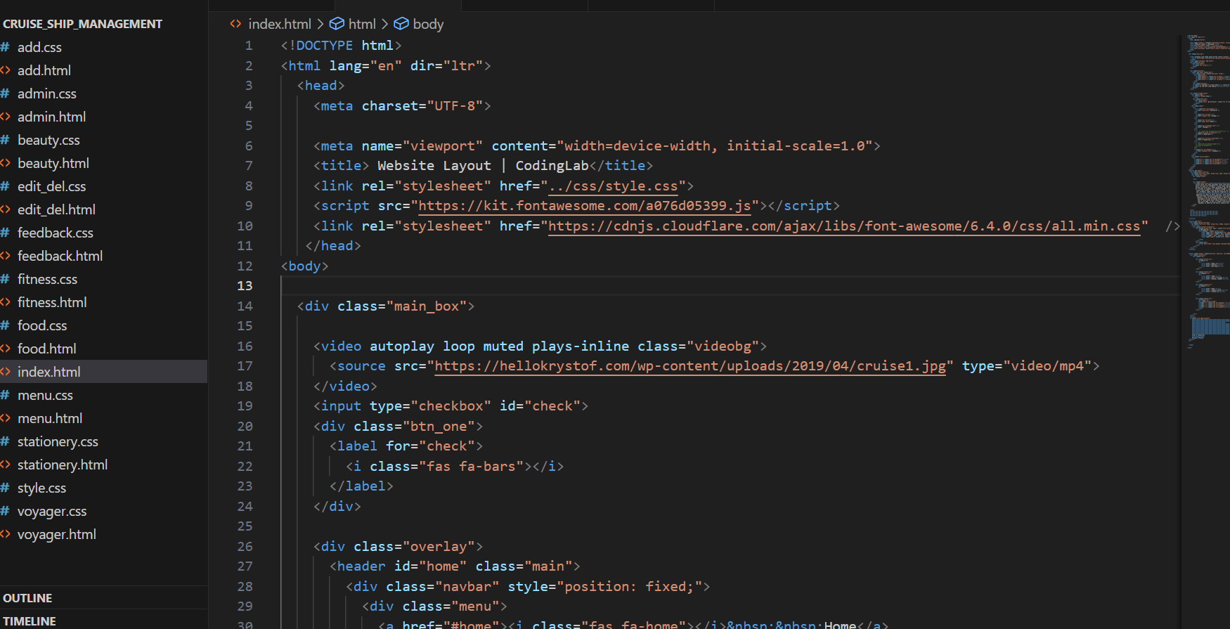

Slide 11
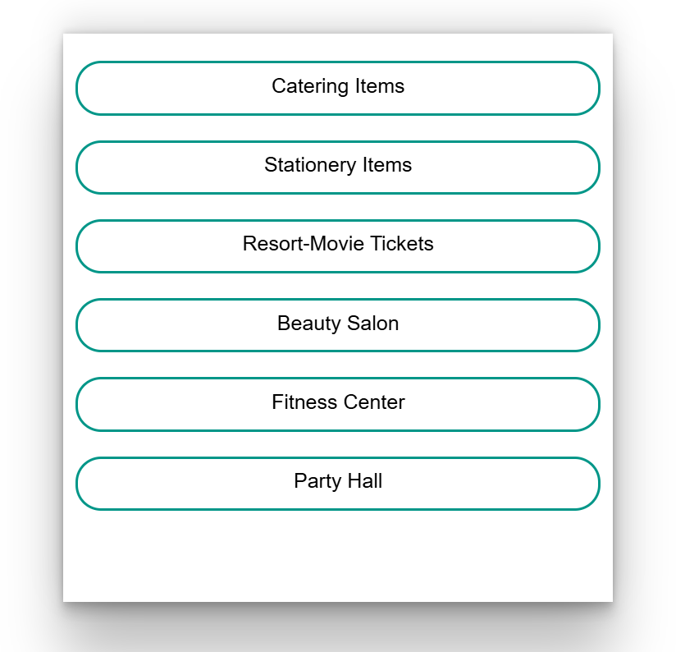
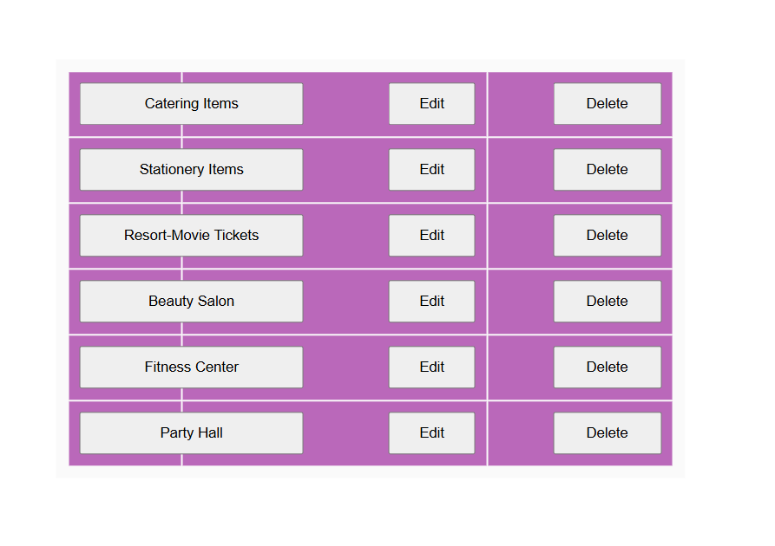

Slide 12
Key Features
Voyager Authentication: Secure login for voyagers to protect user data.
Real-Time Booking: Users can book services and view available slots instantly.
Order Management: The system allows easy management of catering and stationery orders.
Service Availability: Check availability of movie tickets, fitness center slots, and party halls before booking.
Logging and Monitoring: Every action performed by the user and system is logged for debugging and monitoring.

Slide 13
Conclusion
Impact: This system enhances the experience for voyagers by providing easy access to services and streamlining operations for the cruise management team.
Learning Outcome: The project showcases practical use of Firebase for real-time data handling, user authentication, and integrating a modular web design.

